Slide 1

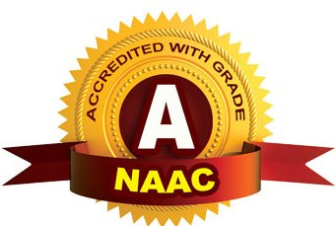
CMR TECHNICAL CAMPUS UGC (Autonomous) Kandlakoya, Medchal Road, Hyd-501401 Department of Computer Science and Engineering (Data Science)
A
Major Project On
Authorship Attribution using Deep Learning
BATCH NO: 19
Presented By :
BOTHA PAVANI - 217R1A6719
U. VIJAYA LAKSHMI - 217R1A6761
ABBA SHASHANK - 217R1A6704
UNDER THE GUIDENCE OF:
Mr. A.LAKSHMAN
Assistant Professor

Slide 2
CONTENTS
Understanding the Problem
Literature Review &Summary
Analysis & Design
Design
References

Slide 3
Understanding The Problem
Authorship attribution refers to the process of identifying the author of a given text based on linguistic features, writing style, and patterns that are unique to individual authors. Deep learning, particularly through neural networks, has proven to be a powerful tool in this domain due to its ability to learn complex patterns In large datasets without requiring explicit feature engineering.
Identifying Authorial Style: Every writer has a unique writing style influenced by vocabulary, sentence structure, punctuation usage, and other factors. Distinguishing these subtle differences is complex but critical for accurately attributing authorship.
Lack of Labeled Data: Deep learning models require a large amount of labeled data (i.e., texts by known authors). In many cases, obtaining such datasets can be challenging, especially for rare or less-known authors.
Feature Extraction Complexity: Traditional methods for authorship attribution rely on hand-crafted features (e.g., word frequency, punctuation patterns). Deep learning models, particularly recurrent neural networks (RNNs) and transformers, aim to automatically learn these features, but choosing the right architecture and training them effectively can be tricky.

Slide 4
Literature Review and Summary
TITLE | AUTHOR | JOURN-AL NAME | PUBLISHED YEAR | SUMMARY
Authorship Attribution in Historical and Literary Texts by a Deep Learning Classifier | Ehsan Reisi, Hassan Mahboob Farimani | Journal of Applied Intelligent Systems & Information Sciences | 2020 | This study proposes a deep learning approach using a convolutional neural network (CNN) with self-attention for authorship attribution. The method improves accuracy by 2% compared to existing techniques and was applied to the Persian book Khān al-Ikhwān, confirming its authorship by Nāsir-i Khusraw.
Convolutional Neural Networks Based Fire Detection in Surveillance Videos | Authors not specified | IEEE Xplore Digital Library ieeexplore.ieee.org | 2021 | The paper reviews various deep learning-based methods for authorship attribution in English texts and discusses techniques for adapting these solutions to different contexts.
Machine Learning Approaches for Authorship Attribution using Source Code Stylometry | Riley White, Nathan Sprague | IEEE Xplore Digital Library | 2021 | This work describes a machine learning framework that integrates features extracted using natural language processing techniques to identify the authorship of source code.

Slide 5
Design & Analysis
Data Collection and Preparation:
Dataset: Use publicly available datasets like the Enron Email Dataset or IMDb Reviews for initial training, or build a custom dataset if domain-specific authorship is required.
Model Selection:
Deep Learning Models: Choose CNNs for extracting structural features and RNNs (LSTMs or GRUs) for capturing sequential dependencies.
Evaluation Metrics:
Use metrics like accuracy, precision, recall, and F1 score to evaluate the model's performance. Additionally, confusion matrices can help identify common misattributions.

Slide 6
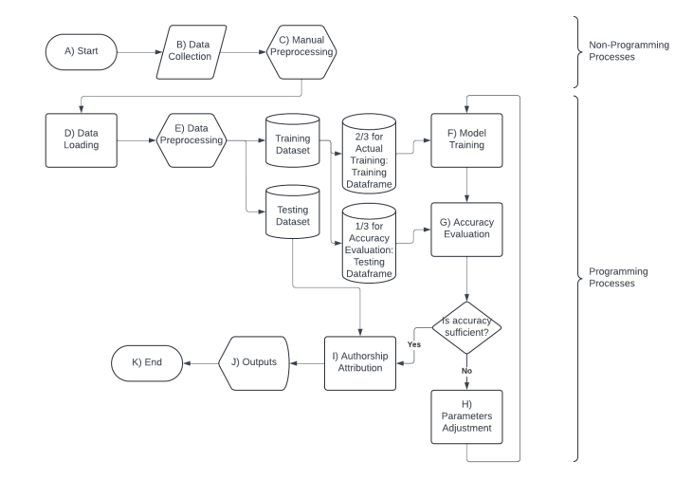
Design

Slide 7
Reference
Anonymous Authors (2022). Authorship Identification Using Ensemble Learning. Published in Scientific Reports. https://www.nature.com/articles/s41598-022-13690-4
Linnaeus University (2023). Deep Learning Techniques for Authorship Attribution of Literary Texts. Linnaeus University Research. https://lnu.diva-portal.org/smash/get/diva2%3A1881000/FULLTEXT01.pdf
Kumarage, T., & Liu, H. (2023). Neural Authorship Attribution: Stylometric Analysis on Large Language Models. arXiv preprint. https://arxiv.org/abs/2308.07305

Slide 8
THANK YOU

